Slide 1
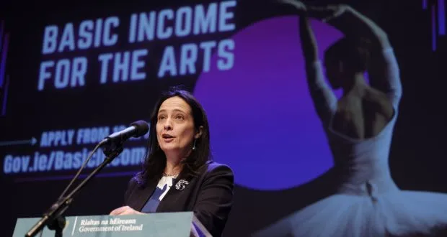
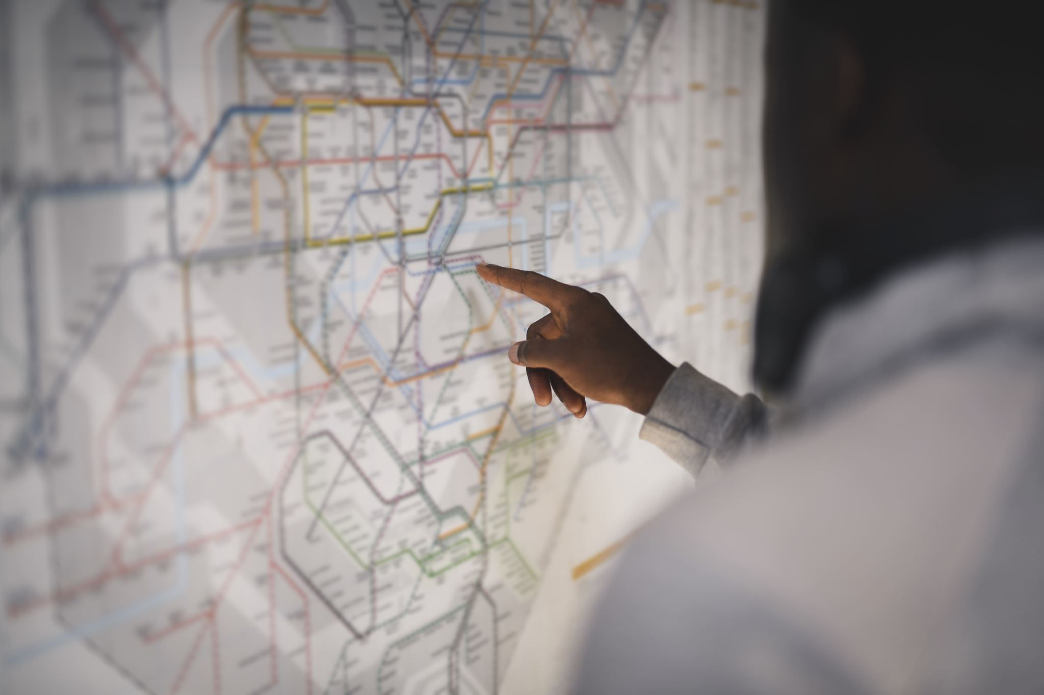
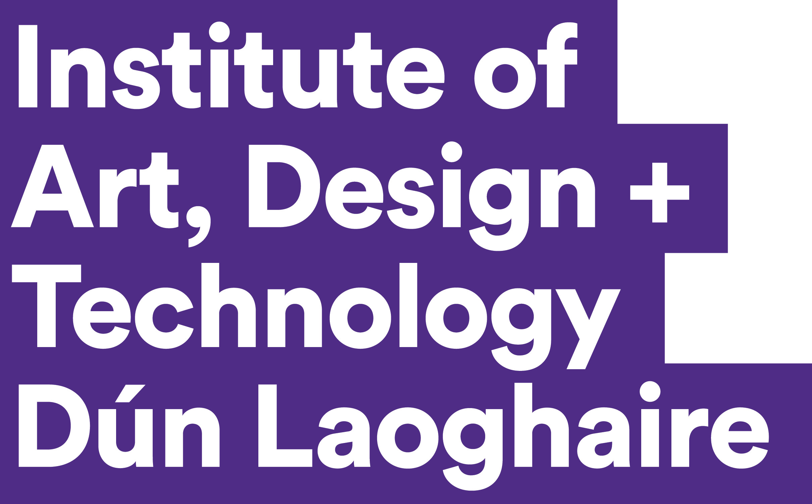
Paraic Mc Quaid
Institute of Art Design and Technology

Slide 2
Background
Artist, Lecturer, Independent Researcher
Also currently in role of Creation Bridge Lead for the Innovate Project.
Research on Basic Income for Artists conducted for recent article on this topic for Cultural Trends Journal published in July 2025, co-authored with Satu Teppo.
Open Access here: https://www.tandfonline.com/doi/full/10.1080/09548963.2025.2525211#d1e134
Presented on the BIA at BIEN conference, Bath, UK, and Compendiumd of Cultural Policies Conference, Pogorica, Montenegre, 2024.
International interest about the question of artists precarity in general and on basic income in particular.

Slide 3
The Basic Income for Arts (BIA) Pilot Scheme
3-year Pilot Scheme testing impact of a basic income on artists
Purpose of pilot – to investigate the suitability of a basic income style payment for supporting artists and artistic work.
2022-2025 (now extended to February 2026)
€325 per week.
2000 in treatment group (randomly selected – demographically representative sample)
997 in control group
Notes:
The national average (mean) annual salary in Ireland was €50,945 as of Q4 2024, according to the Central Statistics Office (CSO), though the median salary of €43,221 (based on 2023 CSO data) provides a better representation of the typical worker's earnings
Social welfare MTB – Means tested Benefit – Job seekers Allowance - €232; Job seekers benefit €232
Cost of living in Ireland – €950 – €1200 per month for single person, exluding rent

Slide 4
The Basic Income for Arts (BIA) Pilot Scheme
Over 9000 applied for the scheme – 8200 eligible
Total number of artists in Ireland – circa 55,000
Definition of arts – Arts Act 2003.
Not means-tested
Unconditional payment – no expected return. – not a labour activation scheme.
The BIA only fits 4 of the 5 criteria of Universal Basic Income – cash payment, periodic, individual, unconditional (apart from form filling for research data)
The other 1 is Universal.
Notes:
Definiton of Arts under Arts Act, 2003 –"arts" is defined as "any creative or interpretive expression (whether traditional or contemporary) in whatever form, and includes, in particular, visual arts, theatre, literature, music, dance, opera, film, circus and architecture, and includes any medium when used for those purposes".
Eligability – differs from the Covid PUP in that it is only for sub-categories of Arts Act and not wider arts workers such as sound technicians, camera operators, etc.
All applicants must be: 18 years of age or older; in a position to evidence their creative practice or career in the arts; based in the Republic of Ireland; tax compliant
Who is not eligible to apply
applicants who cannot demonstrate that they have a creative practice in an art-form or that their creative work makes a key contribution to the production, interpretation or exhibition of the arts
full-time students or those who will be engaged in full-time study during the period October 2022 to October 2025. (Those who will complete training / graduate by October 2022 are welcome to apply)
Aosdána members in receipt of the Cnuas
Tax:
these payments will be reckonable for the purposes of income tax. All successful participants will need to register with Revenue as self-employed and pay Schedule D income tax, where appropriate, on the BIA grant payment income from the pilot will be liable for Class S PRSI
the Department of Social Protection (DSP) will treat income from the scheme as income from self-employment for the purpose of its various means tests. This means that where a scheme includes a disregard of a certain amount of income from self-employment, that disregard will be applied to income from the basic income pilot. It should be noted that not all means-tested schemes include disregards for income from self-employment.
The extent to which this income will have an impact on a person’s DSP payment will depend on the means test for that scheme and the person’s individual circumstances (in particular whether the person and/or their spouse/partner has other means)
applicants are strongly advised to investigate what their own particular tax and social welfare situation may be should they receive payment those in receipt of a social welfare payment who receive payments from the pilot scheme should advise the Department of Social Protection of this change in their circumstances

Slide 5
How does this scheme compare with other arts funding?
Other Artist Supports
Artist Tax Exemption
Tax incentive for Film
Social Welfare
Arts Council Fund
Local Authority Arts Fund
Creative Ireland Funding
Aosdána – Cnuas fund
The BIA Pilot
Funding for arts workers.
non-competitive, no excellence criteria.
Not proposed as replacement of existing funding –complement.
Highlights artists role in a democratic society.
Not an employment activation measure (job seekers allowance)

Slide 6
How did BIA enter the realm of cultural policy?
Department of Tourism, Culture, Arts, Gaeltacht, Sport and Media (TCAGSM)
Catherine Martin: Minister responsive to the arts – singer, artists in the family.
UBI trial commitment in coalition’s Programme for Government (2020)
UBI – background paper and commitment of government in 1997
Commission for UBI, Fianna Fail, 2016 general election manifesto

Slide 7
How did BIA enter the realm of cultural policy?
The Irish Green Party followed European green party – formal policy document in 2019
Aosdána established 1981
Social Welfare Scheme for Professional Artists – Jobseeker’s Allowance – INTREO - 2017. First recognition of art as a profession
National Campaign for the Arts (NCFA) – were particularly effective PR wise from 2018.
Covid-19 Pandemic – Arts and Culture Recovery Taskforce – Pandemic Unemployment Payment (PUP)

Slide 8
How did BIA enter the realm of cultural policy?
Cultural Policy model – Garbage can model, or Multiple Streams Framework – ambiguity in terms of understanding of the policy problem and time in terms of a window of opportunity presenting itself to implement policy.
Direct support for artists has been in place in Ireland since the early 1970’s.
Consensus model democracy – brought about by forced coalition governments – potential consensus approach to political decision making - current government coalition not as cooperative.
BIA a possible concession when Green party really wanted a UBI pilot.

Slide 9
Shift in Narrative around value of arts?
Our paper argues that the BIA is representative of a positive shift in valuing of arts and artists in society in Ireland.
Official government statements about the BIA pilot scheme have placed increased emphasis on the intrinsic value of the arts. For example, Minister Martin has stated that:
“The Basic Income makes a strong statement at home and abroad about the value that Ireland as a nation places on artistic practice both in terms of our personal and collective wellbeing, and also the importance of the arts to our identity and cultural distinctiveness.” (Department of Tourism Citation2024b)
Covid shifted narrative – ground level understanding of what was missed out on during lock down – renewed appreciation of arts (not all equally)
PUP payment – no public, political or media opposition to paying artists as their role was understood in line with service sector

Slide 10
Shift in Narrative around value of arts?
Public recognition of precarious living and working conditions of artists.
The service they provided found new appreciation – culture as a connector and a mediator of experiences.
Apart from PUP there were huge increases in public spending on arts and culture. Minor increases for 10 years post recession then 2019 – 2023 73% increase in funding
Arts and Culture Recovery Taskforce Report commissioned – recommended UBI. - Minister moved to implement immediately.
No public outcry or political opposition of “why artists?”

Slide 11
Dark clouds on the Narrative shift?
Negative government narrative has crept back in.
Government have thrown a few attempts to undermine this growth in valuing of artists, by spinning certain narratives in February 2025: story appeared about waste of tax-payers money on expensive image scanner for National Gallery that could not fit into the space where it was required at a cost of €124k. The facts related to a purchase in 2017.
Newly elected Minister for Culture, Communications and Sport Patrick O’ Donovan (Fine Gael) said it has caused huge embarrassment for his department.
Arts Council of Ireland committed to a public tender €5.3m for an IT system that would help make applying for and assessing funding easier. The company failed to deliver and kept the money.
RTE – public service broadcaster – scandals around levels of pay and special private funded salary boosts

Slide 12
Costs
& Potential Costs
(overly simplistic view – many variations)
€25 million for 2000 artists
€687.5 million for 55,000 artists
€50 billion for UBI (ESRI, 2019)
2.7million workforce (CSO, 2024)
€58.4 billion for Social Welfare 2022 – Covid - €2.6 billion for unemployment
Notes:
ERSI, 2019 – based on 60% of the median income - €1200 per month or €300 per week.
Social welfare expenditiure 2019 - €20.9 billion
John Baker and David Quinn of Universal Basic Income Ireland – €41.3m (A Model of Basic Income for Ireland, 2019) €203 per week
The national average (mean) annual salary in Ireland was €50,945 as of Q4 2024, according to the Central Statistics Office (CSO), though the median salary of €43,221 (based on 2023 CSO data) provides a better representation of the typical worker's earnings.
€25.2b for Social Welfare in 2024

Slide 13
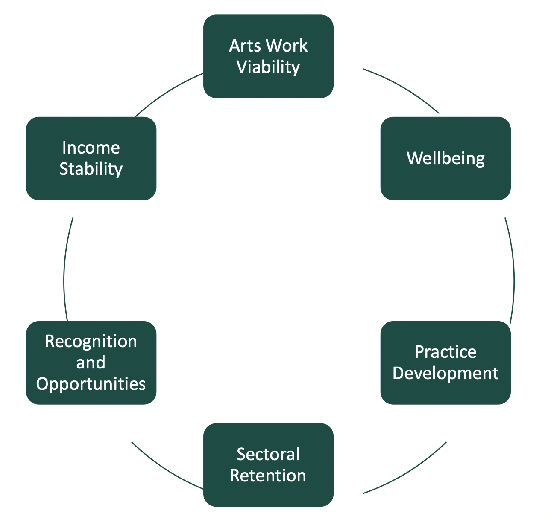
The Research attached to the Pilot
Data collected about the treatment group (2000) and the control group (997), chosen randomly from eligible applicants (8200).
6 goals – themes of research formed through stakeholder consultation (150).
Survey every 6 months.
Self-reporting.

Slide 14

Key Findings Quantitative Report May 2024
Artists - very high levels of enforced deprivation rates.
Artists invest 40% of the BI back into material costs of their work.
Participants have been able to turn down some unpaid work.
Life satisfaction higher than the control group
Spend less time on work outside of arts practice – more time on their practice.
The level of payment not indexed to inflation

Slide 15
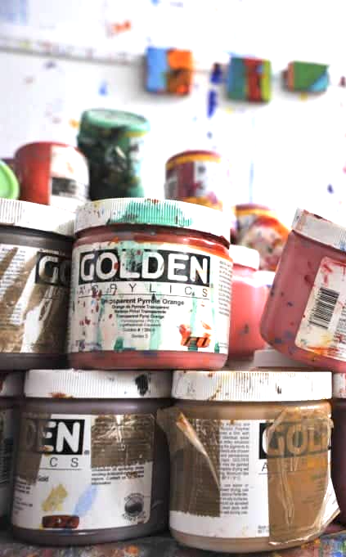
Key Findings Quantitative Report May 2024
“BIA payment is having a consistent, statistically significant impact on almost all indicators; affecting practice development, sectoral retention, well- being, and deprivation.”
12% more time on their practice, 14% more time on experimentation, More art made 65%
Impacts have plateaued since the 6 months marker.
Most significant plateau is deprivation rates. It has not brought artists to levels of deprivation rate of rest of society.
But moved them in this direction.

Slide 16
Key findings from qualitative report May 2025
“Basic Income for the Arts in Ireland – Qualitative Report”, Dr. Jenny Dagg, 2025.
Successes:
Financial Stability and wellbeing – reduction in financial stress.
Creative autonomy – more time and greater self direction
Increased self-efficacy – felt more empowered, confident, and validated in their professional and personal lives
Practice and production – more time dedicated to their artistic work
Challenges:
Impact on Disabled and Migrant artists
Disparities between participating and non-participating artists – guilt
Precarity anxiety – about the scheme coming to an end.
Challenges of the broader socio-economic context
Stresses about budgeting and tax obligations.

Slide 17
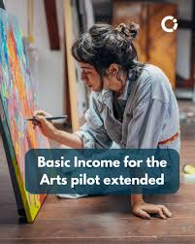
What next?
Commitment by current Minister for Arts and Culture
Election manifestos of November 2024 – many parties in clear support
Green Party lost 11 government seats, has no elected representatives in government and only 1 in opposition.
Coalition government of Fianna Fail and Fine Gael and some ind.
Welfare policy or arts policy?
Will there be a UBI in Ireland?
Proven to impact on deprivation rates, career sustainability etc.
But cannot be effective without reducing inequality in areas of housing, education, healthcare, childcare, gender, etc.

Slide 18
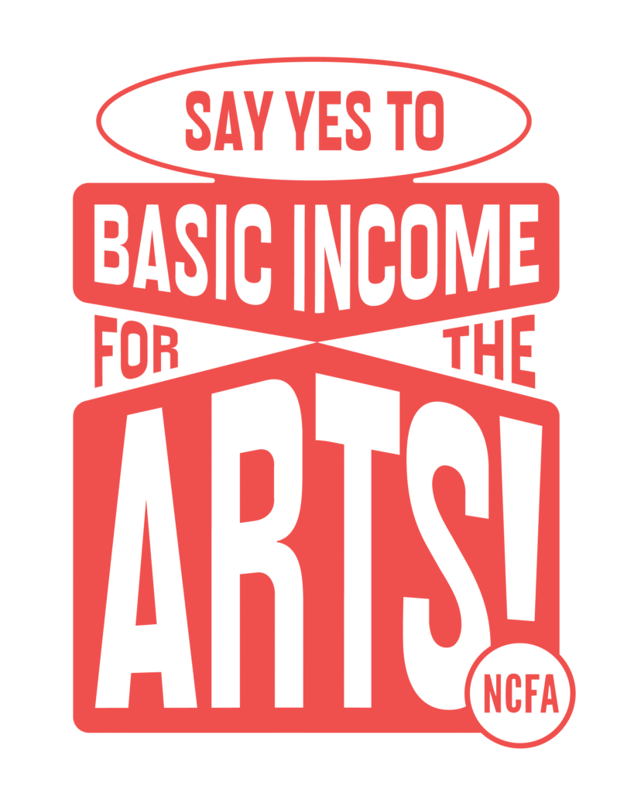
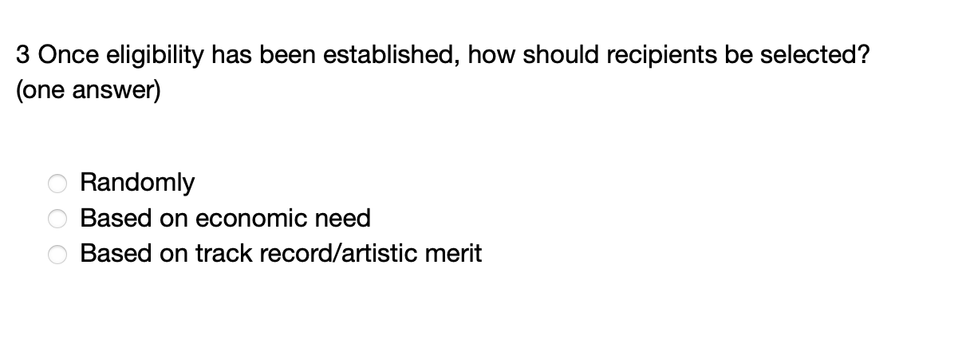
What next?
12th August Minister Patrick O’ Donovan launched a public consultation:
From the short survey there are clear intentions of the Department to: get rid of the non-means tested element; and treat it as a kickstarter rather than continuous payment in recognition of contribution to society. .

Slide 19
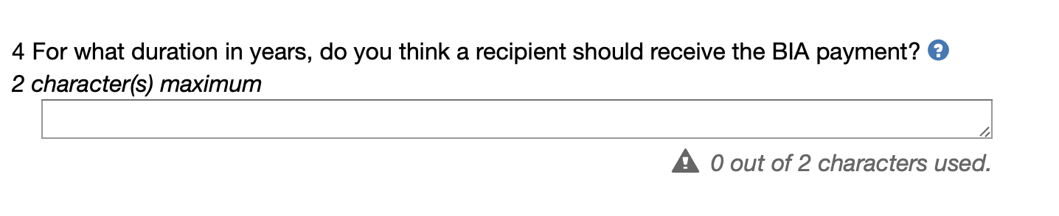
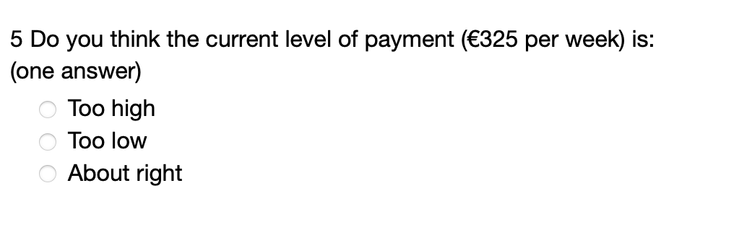
What next?
Most recent survey:

Slide 20
Basic Income as Development
Welfare is presented as anthesis to development within the neoliberal capitalist paradigm.
Workers rights have depleted under the dominating principle of neoliberal development – depletion of power of unions – unions seen as stifling growth of industry.
Ideas of collective action discouraged
Basic Income for Artists is an interesting experiment in countering
But can BIA find a place within the current neoliberal capitalist paradigm? Without compromise.
What if artists do not have to compete against each other for scarce basic resources for survival?
What happens to collective potential of artists?

Slide 21
Links:
Satu Teppo and Paraic Mc Quaid, (2025) Basic Income for the Arts pilot scheme - an Irish case study, Cultural Trends, July 2025:
https://www.tandfonline.com/doi/full/10.1080/09548963.2025.2525211#d1e456
Jenny Dagg, Basic Income for the Arts in Ireland – Qualitative Report, May 2025:
https://assets.gov.ie/static/documents/BIA_Interviews_Report_2025.pdf
Feldkircher, O’Donnell, (2024) Basic Income for the Arts – Impact Assessment (First Year):
https://assets.gov.ie/static/documents/basic-income-for-the-arts-impact-assessment-first-year.pdf
Life Worth Living – The Report of the Arts and Culture Recovery Taskforce, 2022:
https://assets.gov.ie/static/documents/life-worth-living-report-cbf69e69-f4a6-490e-b1da-abbb207267a6.pdf
Irish Government webpage for BIA:
https://www.gov.ie/en/department-of-culture-communications-and-sport/publications/basic-income-for-the-arts-pilot-scheme-reports/
Video link on UBI potential in Ireland:
https://www.youtube.com/watch?v=QBqS60OeTyw

Slide 22

Páraic Mc Quaid
Institute of Art, Design and Technology (IADT) in Dún Laoghaire, Ireland
paraic.McQuaid@iadt.ie

